Slide 1
Neglect
With thanks to
Childrens specialist safeguarding nurses
Kim Weekes and
Kate Lawson

Slide 2
What is neglect ?
NSPCC: Neglect is the ongoing failure to meet a child's basic needs, and is the most common form of child abuse.
A child might be left hungry, dirty, without proper clothing, shelter, supervision or health care. Exposure to experiences not associated with normal childhood experiences.
NSPCC 2020

Slide 3
Defining Neglect
Neglect is the persistent failure to meet a child’s basic physical and/or psychological needs, likely to result in the serious impairment of the child’s health or development. Neglect may occur during pregnancy as a result of maternal substance abuse. Once a child is born , neglect may involve a parent or carer failing to:
Provide adequate food clothing & shelter (including exclusion from home or abandonment)
Protect from physical & emotional harm or danger
Ensure adequate supervision(including use of adequate caregivers)
Ensure access to appropriate medical care or treatment
It may also include neglect of, or unresponsiveness to, a child’s basic emotional needs. Working together to safeguard children (HM Government 2018).

Slide 4
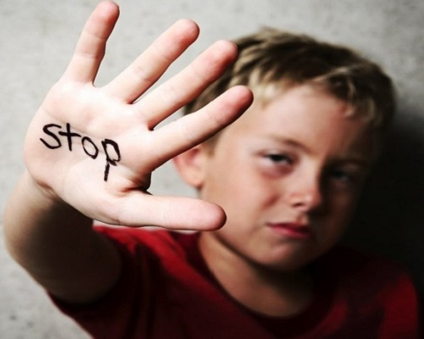
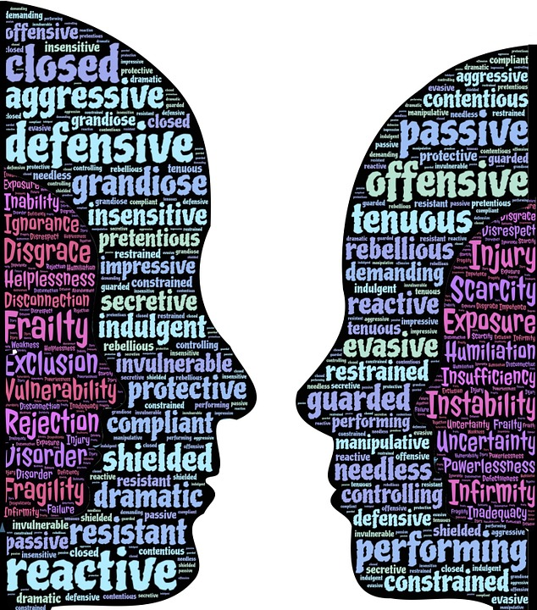
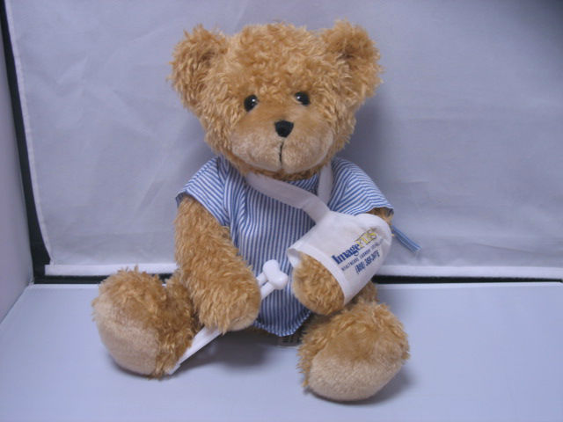
Neglect is… There are 4 main types of neglect. ( NSPCC 2020)
Physical
Educational
Emotional
Medical
Group work
This Photo by Unknown Author is licensed under CC BY-SA-NC
This Photo by Unknown Author is licensed under CC BY-SA
Notes:
The NSPCC suggest there are four main types of neglect however these can be categorised differently, and there is a lot of cross over of the signs and symptoms.
Give each group category, to list think about what children may experience under these headings

Slide 5
Looking out for….Educational Neglect
Poor school attendance, on a regular basis or in line with other events in the home.
Reasons given for non attendance are constantly poor, inaccurate,
Support given to help attend school not accessed, or disguised compliance
Child showing signs of child criminal exploitation/child sexual exploitation
Failure to thrive in in education or lapsing in normal ability

Slide 6
Looking out for ….Physical Neglect
Bruises , marks scrapes, consistency of these and child's reports of how happened.
Child unkempt, smelling, dirty clothes, ill fitting shoes, dirty/uncut nails/hair, weight obese or underweight.
Long term chronic health conditions such as head lice/common viral infections/ bed bugs/worms/ scabies/nappy rash ETC.
Poor/irregular diet, and fluids, dental cavities, often poorly or rundown, tired.
Home conditions poor, essentials not present for cooking, cleaning, heating, bathing, in reasonable repair, animal care, risk to children.
Safety and supervision and support.
Ongoing persistent other abuse such as Domestic abuse

Slide 7
Looking out for …..Emotional Neglect
Warmth and care, response to child/children
Caring responsibilities the child has,
Boundaries,
Again Domestic abuse
Values; actively encourages negative attitudes, condones poor/ anti social behaviour
Allows viewing of inappropriate computer or TV content.
Substance misuse
Safety and supervision, parents unconcerned regarding child where abouts.
Child left in care of other children or unsuitable person.
Fabricated or induced illness, parents seeking diagnosis/ label for child.
Grooming
Notes:
Other types of neglect which fit in to these categories
Middle class neglect – working mothers, divorce, nannies and after school activities mean our children are seeing less of their parents.
Institutional neglect- school giving detentions for uniform, which the child does not have,
Adolescence neglect – leaving children to it

Slide 8
Looking out for ….Medical Neglect
Poor attendance to appointments
Requesting interventions assessments but not attending even if arranged for at home.
Failure to recognise impact of incomplete treatment /care on the child.
Not completing courses of treatments
Ongoing untreated health conditions, only seeking treatment in an emergency.
Disguised compliance
Indifference to advice given, hostile to advice given on impact of drugs and alcohol and smoking,
Disabilities or health conditions which need extra attention to are not met and or parents hostile to professionals knowledge offered.

